Slide 1
UNIT-2 Test Case Design Techniques
Introduction :
Test Case,
Types of Test Cases,
Test Case Template How to write a test case with examples,
Preparing Review Report.
Writing Test Plan,
Preparing Traceability Matrix
Writing Test Execution Report and Summary Report
Software Test Life cycle:
Concept of Software test life cycle
Software Bugs :
Types of Bugs,
Identifying the Bugs,
Reporting the Bugs
Notes:
Test cases are detailed, step‑by‑step instructions used in software testing to verify whether a particular feature or function of an application works as expected.
In simple words
A test case tells the tester:
What to test
How to test
What result to expect
If the actual result matches the expected result, the test case passes; otherwise, it fails.
Purpose of test cases
Ensure the software meets requirements
Detect defects or bugs early
Improve software quality
Provide clear documentation for testing

Slide 2
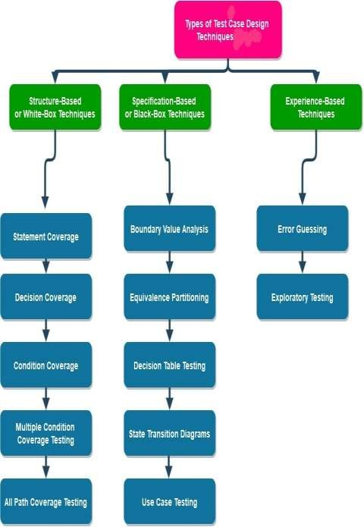
Types of Test Case Design Techniques:
Basics of Test Case Design Techniques:
Test cases are essential to ensure that the end product meets the desired requirements and standards.
Test cases typically contain a set of inputs, expected outputs, and
conditions that must be met for the test to pass.
we can identify any defects or issues in the product and address
them before the product is released to the end-users.
Various test case design techniques help us design a robust and reliable test case that covers all our software’s features and functions.
These design techniques implicate multiple measures that aim to guarantee the effectiveness of test cases in finding bugs or any other defects in the software.
Fix issues before releasing the product to end users
Without test cases, software may reach users with serious problems.

Slide 3
Specification-Based or Black-Box Techniques
In this technique, we design our test cases for the testing at or near the border values. Test cases often contain values from the upper boundary and the lower boundary.
Specification-based testing, also known as black-box testing, is a technique that concentrates on testing the software system based on its functioning without any knowledge regarding the underlying code or structure.
This technique is further classified as:
To make our task more manageable, BVA offers us four main test scenarios, as mentioned below.
Minimum
Just below the boundary values
Maximum
Just above the boundary values
Boundary Value Analysis (BVA)
Equivalence Partitioning (EP)
Decision Table Testing
State Transition Diagrams
Use Case Testing
Notes:
Black‑Box Testing is Applied
The tester:
Does not know how the age validation code is written
Only checks whether correct output is shown for given inputs
Advantages of Black‑Box Testing
No programming knowledge required
Easy to understand and execute
Focuses on user requirements
Helps find missing functionality

Slide 4
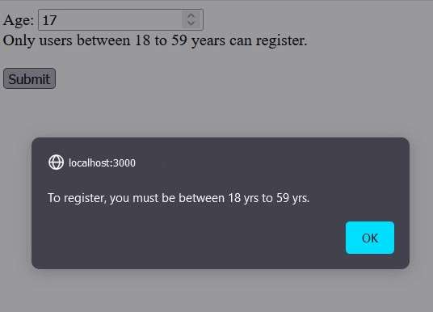


Let’s understand this test case design technique by taking a simple
example for a user age validation input form.
Fg
Test Name: Validate user age in the input form.
Test Condition: A valid adult user must be between [18 and 59 yrs], both inclusive.
Boundary Value Analysis: To ensure this functionality works, we can test the boundaries of the possible inputs. Possible valid inputs for this test are natural numbers between 18 to 59.
Expected Behavior: If the input age is not valid (i.e. age < 18 or age >=60), then the form must prompt a “To register, you must be between 18 yrs to 59 yrs.” alert.

Slide 5
Hence the designed test cases will be as follows:
Test Case 1: (Just Below Minimum)
Input: age = 17
Expected Output: “To register you must be between 18 yrs to 59 yrs.” alert popups.
Test Case 2: (Minimum)
Input: age = 18
Expected Output: Proceed to Registration.
Test Case 3: (Maximum)
Input: age = 59
Expected Output: Proceed to Registration.
Test Case 4: (Just Above Maximum)
Input: age = 60
Expected Output: “To register, you must be between 18 yrs to 59 yrs.” alert popups.
Equivalence Partitioning (EP)
In the Equivalence Partitioning technique for testing, the entire range of input data is split into separate partitions.
All imaginable test cases are assessed and divided into logical sets of data named classes.
One random test value is selected from each class during test
execution.
Test cases design Equivalence Partitioning:
To test the functionality of the user age from the input form (i.e., it must accept the age between 18 to 59, both inclusive; otherwise, produce an error alert), we will first find all the possible similar types of inputs to test and then place them into separate classes.

Slide 6
In this case, we can divide our test cases into three groups or classes:
Age < 18 – Invalid – ( For e.g. 1, 2, 3, 4, …, up to 17).
18 <= Age <= 59 – Valid – ( For e.g. 18, 19, 20, …, upto 59).
Age > 59 – Invalid – (For e.g. 60, 61, 62, 63, …)
We have infinite test cases to pick, but we only need to test one value from each class.
Decision Table Testing
A Decision Table is a technique that demonstrates the relationship between the inputs provided, rules, output, and test conditions.
In test case design techniques, this decision table is a very efficient way for complex test cases.
The decision table allows automation testers or developers to inspect all credible combinations of conditions for testing. True(T) and False(F) values signify the criteria.
This reduces the number of tests we need to perform but increases our test coverage.
So, we can perform these tests for a definite number only, and the test value will be picked randomly from each class and track the expected behavior for each input.
Notes:
Decision Table Testing?
Decision Table Testing is a black‑box test design technique used to test different combinations of inputs (conditions) and their corresponding outputs (actions).
Conditions / Test CasesTC1TC2TC3TC4Image format is JPEGTTFFImage size < 1 MBT
When to Use Decision Table Testing
When multiple conditions affect the output
For business rules, validations, and complex logic
When all combinations must be tested clearly

Slide 7
Decision table testing is a test case design technique that examines how the software responds to different input combinations.
Test Name: Test upload image form.
Test Condition: Upload option must upload image(JPEG) only and that too of size less than 1 Mb.
In this technique, various input combinations or test cases and the concurrent system behavior (or output) are tabulated to form a decision table.
Expected Behavior: If the input is not an image or not less than 1 Mb in size, then it must pop an “invalid Image size” alert; otherwise, it must accept the upload.
That’s why it is also known as a Cause/Effect table, as it captures
both the cause and effect for enhanced test coverage.
Test Cases using Decision Table Testing:
Based upon our testing conditions, we should test our software
system for the following conditions:
Automation testers or developers mainly use this technique to make test cases for complex tasks that involve lots of conditions to be checked.
The uploaded Image must be in JPEG format.
To understand the Decision table testing technique better, let’s consider a real-world example to test an upload image feature in the software system.
Image size must be less than 1 Mb.
If any of the conditions are not satisfied, the software system will display an “invalid input” alert, and if all requirements are met, the image will be correctly uploaded.

Slide 8
State Transition Testing:
Now, let’s try to make the decision table to design the most
suitable test cases.
State, Transition Diagram Testing, is a software testing technique used to check the transformation in the state of the application or software under changing input.
The requirement of the input passed is varied, and the
change in the state of the application is observed.
State Transition Testing is mainly carried out to monitor the behavior of the application.
In this type of testing, negative and positive input values are passed, and the behavior of the application or software is observed.
To perform State transition testing efficiently on complex
systems, we take the help of the State transition
diagram or State transition table.
The state transition Diagram or state transition table
mainly represents the relation between the change in
input and the behavior of the application
Conditions | Test case 1 | Test case 2 | Test Case 3 | Test case 4
Image Format | .jpg/.jpeg (T) | .jpg/.jpeg (T) | Not .jpg/.jpeg (F) | Not .jpg/.jpeg (F)
Image Size | < 1Mb (T) | >= 1 Mb (F) | < 1 Mb (T) | >= 1Mb
Output | Upload image (T) | Invalid input (F) | Invalid input (F) | Invalid input (F)
Notes:
What is State Transition Testing?
State Transition Testing is a black‑box testing technique used to verify how a system behaves when it moves from one state to another based on different inputs or events.
A state is a condition or situation in which the system exists at a specific time.
A transition is the change from one state to another caused by an input or event.
👉 This technique is mainly used when the output depends on the current state and the input.

Slide 9
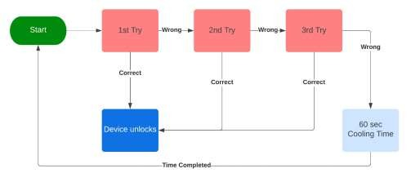
A real-world example where State Transition Testing is performed can be an ATM machine.
State Transition Diagram:
Let’s understand this testing technique by considering an example of a mobile passcode verification system.
Test Name: Test the passcode verification system of a mobile to
unlock it.
Expected Behavior: The Phone must unlock when the user enters a correct passcode otherwise, it will display an incorrect password
message.
In the state transition diagram, if the user enters the correct passcode in the first three attempts, he is transferred to the Device unlock state, but if he enters a wrong passcode, he is moved to the next try, and if he repeats the same for 3 consecutive times the device will go on a 60 sec freezing period.
Also, if 3 consecutive times an incorrect passcode is entered, the device will go on a cooling period for 60 sec to prevent a brute force attack.
Notes:
brute force attack.-cybersecurity hacking method that uses trial and error to crack passwords,login credentials..
States in This System
Start
1st Attempt
2nd Attempt
3rd Attempt
Access Granted (Unlocked)
Cooling Period (Locked)

Slide 10
Use Case Testing:
State Transition Table:
Similar to the above state transition diagram, we can also design our test case using the state transition table.
The state transition table for this particular example is as follows:
As the name suggests, in Use case testing, we design our test cases based on the use cases of the software or application depending on the business logic and end-user functionalities.
It is a black box testing technique that helps us
identify test cases that constitute part of the whole system on a transaction basis from beginning to end.
A use case testing technique serves the following
objective:
Manages scope conditions related to the project.
Depicts different manners by which any user may
interact with the system or software.
States | Correct Passcode | Incorrect Passcode
1).Start | Go to step 2. | Go to step 2.
2).1st try | Go to step 5. | Go to step 3.
3).2nd try | Go to step 5. | Go to step 4.
4).3rd try | Go to step 5. | Go to step 6.
5).Access Grant | – | –
6).Cooling Period | –
Notes:
Use Case – Meaning
A use case describes how a user interacts with a system to achieve a specific goal.
It explains:
Who the user is
What the user wants to do
How the system responds step by step
Use Case: Withdraw Cash
User inserts ATM card
User enters PIN
User selects withdrawal
User enters amount
System dispenses cash

Slide 11
Visualizes the system architecture.
The device must not accept a passcode when the cooling period
is active.
Permits to assess the potential risks and system reliance.
Communicates complex technical necessities to
stakeholders easily.
The user should be able to unlock the device after the expiry of the cooling period by entering a correct passcode.
relevant
Let’s understand the Use case testing technique using our last example of a mobile passcode verification system.
Before moving on to the test case, let’s first assess the use cases for this particular system for the user.
The user may unlock the device on his/her first try.
Someone may attempt to unlock the user’s device with the wrong passcode three consecutive times. Provide a cooling period in such a situation to avoid brute-force attacks.

Slide 12
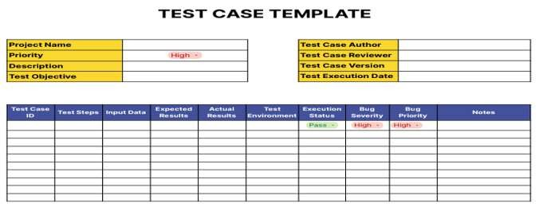
What is test case?
What is a Test Case Template?
Test cases are an important aspect of software testing.
A test case template is a predefined structure that provides a
standardized way to document and create test cases.
We have provided them as guidelines for testers to ensure that all necessary information about a test scenario is captured consistently across different test cases.
With a good test case template, testing teams can maintain
uniformity and improve the clarity and completeness of
their test documentation.
They are designed to verify the functionality and reliability of a software system by outlining specific steps to be taken, input data to be used, and expected outcomes.
The purpose of test cases is to determine whether the software
behaves as intended under various scenarios and conditions.
Test cases are typically documented in a dedicated testing document (such as Google Sheets, or text document) or a test case management tool (TestRail, Zephyr, qTest, and PractiTest).

Slide 13
Test Case Components
9. Test Environment: Details about the system, hardware,
software, and configurations used for testing.
No matter what method to document the test case was chosen, we should include the following fields in the test case:
1. Test Case ID: A unique identifier for the test case.
10. Test Data Preparation: Instructions on how to set up the required test data.
2. Title/Description: A concise description of the purpose of the test
case.
11. Test Execution Date: The date and time when the test was executed.
3. Test Objective: The specific goal or objective of the test.
12. Test Execution Status: The pass/fail status of the test case after
execution.
4. Preconditions: Any necessary conditions that must be met before the test is executed.
13. Test Conclusion: A summary of the results and observations of the test.
5. Test Steps: A step-by-step sequence of actions to perform during the test.
14. Test Verdict: A judgment about the overall success of the test.
Input Data: The data or parameters to be used as input for the test.
Expected Results: The anticipated outcomes or behaviors after
executing the test steps.
Actual Results: The actual outcomes observed when executing
the test.

Slide 14
Bug Details (optional): If a defect is identified, details about the issue, its severity, and steps to reproduce it. Generally teams will manage the bugs found in another dashboard, but if you want to link the bug found to a specific test case, you can totally include this field there
Attachments: Any relevant files, screenshots, or documentation associated with the test.
Test case review Report:
Test Report is a document which contains a summary of all test
activities and final test results of a testing project.
Test report is an assessment of how well the Testing is performed. Based on the test report, stakeholders can evaluate the quality of the tested product and make a decision on the software release.
For example, if the test report informs that there are many defects remaining in the product, stakeholders can delay the release until all the defects are fixed.
17. Test Case Author: The person responsible for creating the
test case.
Test Case Reviewer: The person who reviewed and
approved the test case.
Test Case Version: The version or revision number of the test case.
Notes/Comments: Additional information, insights, or
comments related to the test case.

Slide 15
Why is Test Case Review Important?
Advantages of the Test Case Review Process in Software Testing?
During the test case review – two viewpoints are incorporated, if
anything is missed by one, that can be provided by the other.
1. Improved Quality: Reviewing test cases helps identify defects,
errors, and omissions early on, leading to higher-quality software.
Test case reviews ensures that all team members are on the same
page about the feature and requirements
2. Enhanced Test Coverage: Reviewing test cases allows for a comprehensive examination of test scenarios, ensuring maximum coverage and minimizing the risk of undiscovered bugs.
During test case reviews, any differences in understanding the requirements can be sorted out sooner.
Who Reviews the Test Cases?
3. Knowledge Sharing: The review process facilitates knowledge sharing among team members, encouragement collaboration and enabling the transfer of domain expertise.
The test case review process is done by the test lead or other test
engineers in the team.
After the author finishes creating test cases, they will be sent to the other test engineers, known as reviewers, for the test case review process.
4. Consistency and Standardization: By reviewing test cases, teams can ensure that testing practices follow to established standards and guidelines, promoting consistency across the testing process.
The reviewer verifies the correctness, accuracy, flow, and coverage of
the test case.
5. Early Issue Identification: Reviewing test cases uncovers issues before actual execution, saving time and effort in the long run and reducing the probability of critical bugs reaching production.

Slide 16
Assignment 2
Q1:What are the Disadvantages of the Test Case Review Process in Software Testing?
Q2: what is bug? Write example for bug report

Slide 17
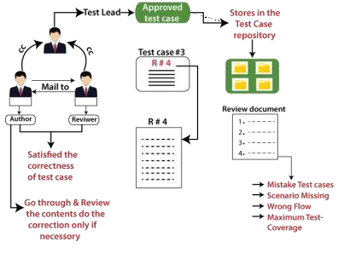
Test case review process
The reviewer opens the test case with the corresponding requirement and checks the correctness of the test case, proper flow, and maximum test coverage.
During this review process, if the reviewer found any mistake, he/she writes it in a separate document, which is known as Review document and sends it back to the author.
When the test engineer writes a test case, he/she may skip some scenarios, inputs and writes wrong navigation steps, which may affect the entire test execution process.
To avoid this, we will do one round of review and approval
process before starting test execution.
If we don't go for the review process, we miss out some scenarios, accuracy won't be there, and the test engineer won't be serious.
Once the author finishes writing the test case, it needs to be sent for the other test engineer known as a reviewer for the review process.

Slide 18
The author goes through all the review comments and starts doing the changes if it is necessary, then send it back once again for the review process.
Test Case Repository:
A test case repository is a centralized location where all the
baseline test cases (written, review, and approved) are stored.
This correction process will continue until both authors, and the reviewer will satisfy.
When the client gives the requirements, the developer starts developing the modules, and the test engineer will write the test cases according to the requirements.
Once the review is successful, the reviewer sends it back to
the test lead for the final approval process.
A test case repository is used to store the approved test cases.
During this approval process, the Team leads are always kept in the loop so that the author and reviewer will be serious in their jobs.
Any test engineer wants to test the application, then he/she
needs to access the test case only from the test case repository.
If we do not require any test case, we can drop them from the test case repository.
When the test cases are written, review, and approved, it will be stored in one centralized location, which is known as Test Case Repository.

Slide 19
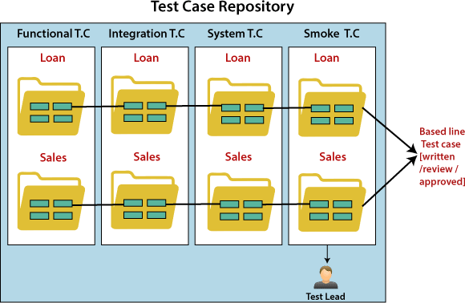
For every release, we maintain a different test case repository.
Review Process
Once the test cases are baselined or stored in the test case repository, they cannot be edited or changed without the permission of the test lead.
While reviewing, the reviewer checks the following aspect in the test cases:
The testing team always has a complete back-up of the test case
repository if any crash happened which is affecting the software.
Template
The reviewer checks whether the template is as per requirements
for the product or not.
•
Header
In the header, we check the following aspects:
All the attributes are captured or not.
All the attributes are relevant or not.
All the attributes are filled or not.

Slide 20
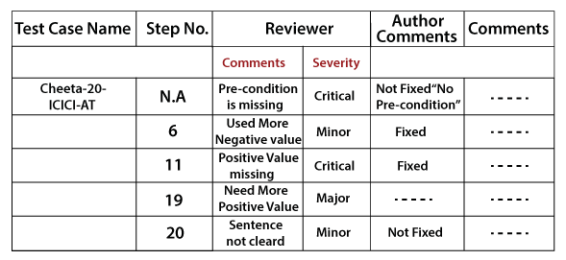
Body
Once the test case is reviewed, the review comments will be sent to
the test case review template.
In the body of the test case, we will check the following aspects:
The test case should be prepared so that it should take minimum time for the execution process.
All the possible scenarios are covered or not.
Look for the flow including maximum test Coverage
The test case design technique is applied or not.
The test case should be simple to understand
Proper navigation is written or not.

Slide 21
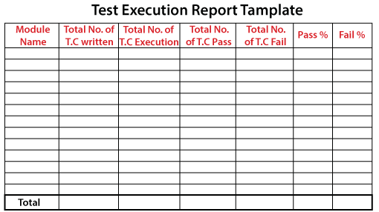
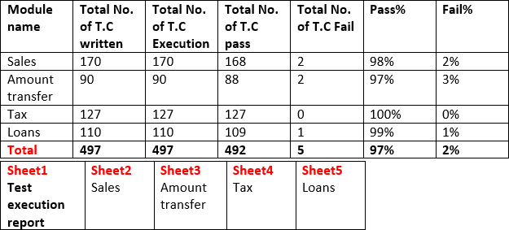
Text Execution Report [Excel]
Ex:
It is the final document, which is prepared by a test lead when the entire testing process is completed.
The test execution report defined the stability of the application and contained the information like the number of cases written, executed, pass, fail, and their percentage.
The test execution report is a final summary report based on which the quality of the application is defined, and it also helps in deciding that the application can be handed over to the customer or not.
Let see one example of a test execution report where we have different modules
such as Sales, Amount transfer, Tax, Loan.
Every module has a separate spreadsheet of their respective
module.

Slide 22
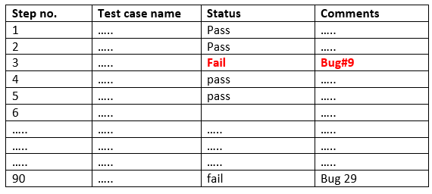
The test lead made this report, and the test engineer sends the individual features that he/she has tested and executed.
The test lead sends this report to the following:
Development Team
Management
Test manager
Customer
Where a development team needs the list of failed test cases.
As we can see in the below table that we have a list of test case
names, related status, and comments.
The below table is showing the amount transfer test case data.
Amount Transfer:

Slide 23
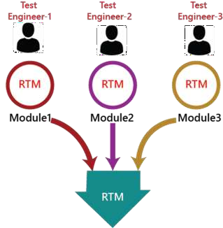
Traceability Matrix
The test engineer will prepare RTM for their respective assign
modules, and then it will be sent to the Test Lead.
Traceability matrix is a table type document that is used in the
development of software application to trace requirements.
The Test Lead will go repository to check whether the Test Case is there or not and finally Test Lead consolidate and prepare one necessary RTM document.
It can be used for both forward (from Requirements to Design or
Coding) and backward (from Coding to Requirements) tracing.
It is also known as Requirement Traceability Matrix (RTM) or Cross Reference Matrix (CRM).
It is prepared before the test execution process to make sure that every requirement is covered in the form of a Test case so that we don't miss out any testing.
In the RTM document, we map all the requirements and corresponding test cases to ensure that we have written all the test cases for each condition.

Slide 24
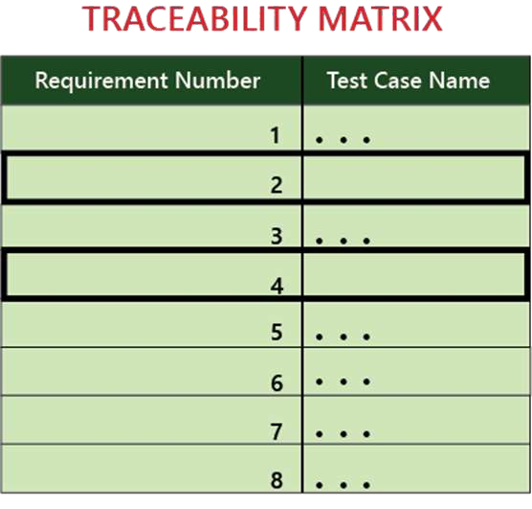
This document is designed to make sure that each requirement has a test case, and the test case is written based on business needs, which are given by the client.
It will be performed with the help of the test cases if any requirement is missing, which means that the test case is not written for a particular need, and that specific requirement is not tested because it may have some bugs.
The traceability is written to make sure that the entire requirement is covered.
We can observe in the below image that the requirement number
2 and 4 test case names are not mentioned that's why we
highlighted them, so that we can easily understand that we have to write the test case for them.
Each requirement in the traceability matrix is connected with its respective test case so that tests can be carried out sequentially according to specific requirements.
Generally, this is like a worksheet document, which contains a table, but there are also many user-defined templates for the traceability matrix.

Slide 25
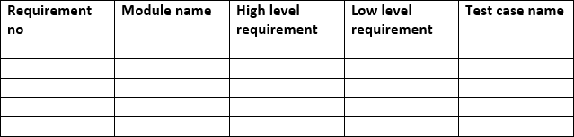
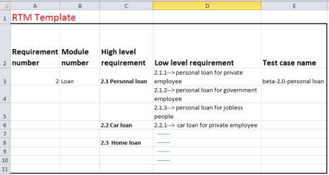
RTM Template:
Goals of Traceability Matrix:
Below is the sample template of requirement traceability matrix (RTM):
It helps in tracing the documents that are developed during
various phases of SDLC.
It ensures that the software completely meets the customer's requirements.
It helps in detecting the root cause of any bug.
Types of Traceability Test Matrix
The traceability matrix can be classified into three different types
which are as follows:
Forward traceability
Backward or reverse traceability
Bi-directional traceability
Example of RTM template

Slide 26
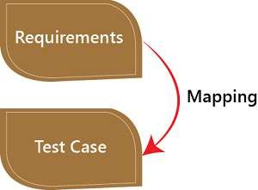
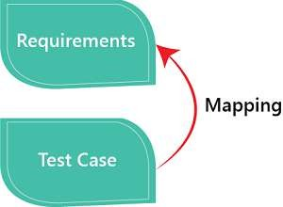
Forward traceability
Backward or reverse traceability
The forward traceability test matrix is used to ensure that every business's needs or requirements are executed correctly in the application and also tested rigorously.
The reverse or backward traceability is used to check that we are not increasing the space of the product by enhancing the design elements, code, test other things which are not mentioned in the business needs.
The main objective of this is to verify whether the product
developments are going in the right direction.
And the main objective of this that the existing project remains
in the correct direction.
In this, the requirements are mapped into the forward direction
to the test cases.
In this, the requirements are mapped into the backward direction to the test cases.

Slide 27
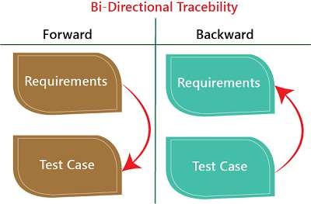
Bi-directional traceability
Advantage of RTM
It is a combination of forwarding and backward traceability matrix, which is used to make sure that all the business needs are executed in the test cases.
Following are the benefits of requirement traceability matrix:
With the help of the RTM document, we can display the complete test execution and bugs status based on requirements.
It also evaluates the modification in the requirement which is occurring due to the bugs in the application.
It is used to show the missing requirements or conflicts in documents.
In this, we can ensure the complete test coverage, which means
all the modules are tested.
It will also consider the efforts of the testing teamwork towards reworking or reconsidering on the test cases.

Slide 28
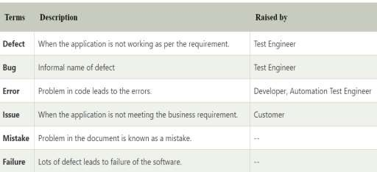

Bug in Software Testing
Basic terminology of defect
Let see the different terminology of defect:
What is a bug in software testing?
The Bug is the informal name of defects, which means that software or application is not working as per the requirement.
Defect
Bug
Error
Issue
Mistake
Failure
In software testing, a software bug can also be issue, error, fault,
or failure.
The bug occurred when developers made any mistake or error while developing the product.

Slide 29
Why defect/bug occur?
For example: if we take the above example and open the inbox link, we see that it is not there only, which means the feature is not developed only.
In software testing, the bug can occur for the following reasons:
Wrong coding
Missing coding
Extra coding Wrong coding:
Wrong coding means improper implementation.
Extra coding:
Here, extra coding means that the developers develop the extra features, which are not required according to the client's requirements.
For example:
For example: Suppose if we take the Gmail application where we click on the "Inbox" link, and it navigates to the "Draft" page, this is happening because of the wrong coding which is done by the developer, that's why it is a bug.
Suppose we have one application form wherein the Name field, the First name, and Last name textbox are needed to develop according to the client's requirement.
But, the developers also develop the "Middle name" textbox, which is not needed according to the client's requirements as we can see in the below image:
Missing coding:
Here, missing coding means that the developer may not have developed the code only for that particular feature.

Slide 30
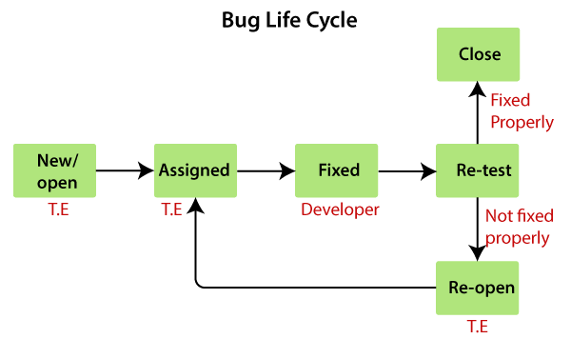
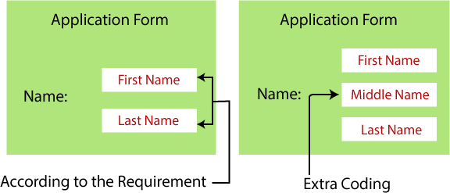
continued…..
Lifecycle of Bugs in Software Testing
As soon as the test engineer finds the bug, status is given as New,
which indicates that a bug is just found.
If we develop an extra feature that is not needed in the requirement, it leads to unnecessary extra effort. And it might also happen that adding up the extra feature affects the other elements too.
This new bug needs to be reported to the concerned Developer by changing the status as Assigned so that the responsible person should take care of the bug.

Slide 31
Now, the Developer first go through the bug, and read all the navigation steps to decide whether it is a valid bug or not.
Re-open, if the bug still exists or not working properly as per the requirement, then the bug sends it back to the Developer once again.
Based on this, if the bug is valid, the Developer starts reproducing the bug on the application, once the bug is successfully reproduced, the Developer will analyze the code and does the necessary changes, and change the status as Fixed.
This process is going on continuously until all the bugs are fixed and closed.
Note1:
The test engineer cannot tell the bug orally to the Developer because of the following reasons:
Developers might ignore the bug
Developer misunderstood the bug
Forget the bug
The bug may not be found in the exact location
Once the code changes are done, and the bug is fixed, the test engineer re-test the bug, which means that the test engineer performs the same action once again, which is mentioned in the bug report, and changes the status accordingly:
Close, if the bug fixes properly, and functionally working
according to the requirement. OR

Slide 32
Whom to assign the bug:
If the old bug is fixed correctly, change the status to Close.
The bug can be assigned to the following:
And if we find a bug in the impact area, then reported as a new bug.
Developers: If we know who has developed that particular module.
If the old bug is not fixed properly, then change the status to Re- open.
Developer lead: If we don't know the Developer who has developed the particular module.
Test lead: When we don't have any interaction with the
development team.
Or, if we find a bug impact area, then change the status to New or
reported as a new bug.
When the bug is fixed and closed or if it is having any impact on
the other module, then we go for a new bug report. OR
When the status of the bug is Re-open (not fixed) and affecting
another module, then we have to prepare the new bug report.
Note2:
Whenever we find a bug and Developers fix it, we have to check one round of impact area.

Slide 33

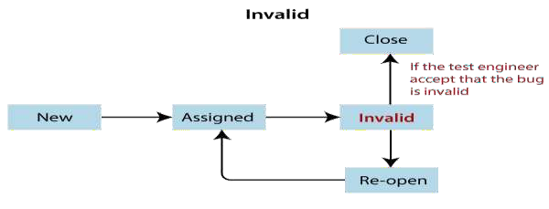
status of the bug:
Invalid / rejected:
Once we prepared a bug report and send it to the Developers, the Developer will accept the bug and starts doing the necessary code changes that become the positive flow of the bug life cycle.
When the Test Engineer wrote an incorrect Bug Report because of misunderstanding the requirements, then the Developer will not accept the bug, and gave the status as Invalid and sent it back. (Sometime Developer can also misunderstand the requirements).
There may be a serval conditions where Developers may not do the necessary code changes and depend on the situation, which becomes a negative flow or status of the bug life cycle.
Following are the different status of the bug life cycle:
Invalid/rejected
Duplicate
Postpone/deferred
Can't fix
Not reproducible
RFE (Request for Enhancement)

Slide 34
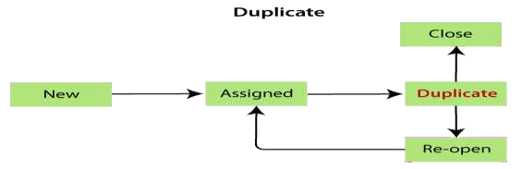
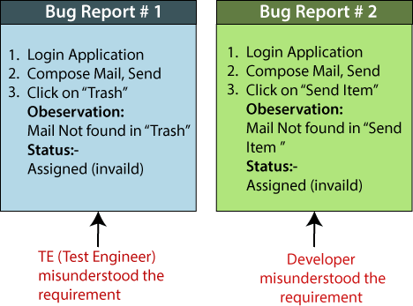
Reasons for an invalid status of the bug
Duplicate:
Test Engineer misunderstood the requirements
When the same bug has been reported multiple times by the different test engineers are known as a duplicate bug.
Developer misunderstood the requirements
Let's see one example where the test engineer and developer misunderstood the requirements as we can see in the below image:
Following are the reasons for the duplicate status:
Common features:
For example: Suppose we have test engineer P and Q which are testing the software, the test engineer P and Q will test their features like login the application.

Slide 35
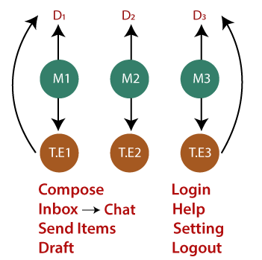
Here, the test engineer P enters the valid username and password, and click on the login button.
Once P click on the login button, it opens a blank page, which means
that it is a bug.
After that, P prepares a bug report for the particular bug and sends it
to the developer.
Then the test engineer Q also login the application and got the same
bugs.
Q also prepare a bug report and send it to the developer.
Once the developer got both test engineers bug report, he/she sends
back the bug report to the Q and say it is duplicate.
To avoid the duplicate bug
If the Developer got the duplicate bug, then he/she will go to the bug repository and
search for the bug and also check whether the bug exist or not.
Dependent Modules:
As we can see in the below image, that the test engineer wants to compose a mail, so first, the test engineer needs to login, then only he/she can able to compose a mail.
If the same bug exist, then no need to log the same bug in the report again.
Or
If the bug does not exist, then log a bug and store in the bug repository, and send to
Developers and Test Engineers adding them in [CC].
If the bug is found in the login module, the test engineer cannot do further process because the composing module is dependent on the login module.

Slide 36
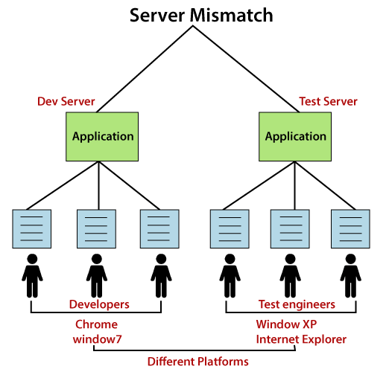
Not Reproducible:
The Developer accepts the bug, but not able to
Server mismatch: Test Engineer is using a different server (Test Server), and the Developer is using the different server (Development Server) for reproducing the bug as we can see in the below image:
Reproduce due to some reasons.
Reasons for the not reproducible status of the bug
Reasons for the not reproducible status of the bug are as
follows:
Incomplete bug report
The Test engineer did not mention the complete navigation
steps in the report.
Environment mismatch
Environment mismatch can be described in two ways:
Server mismatch
Platform mismatch

Slide 37
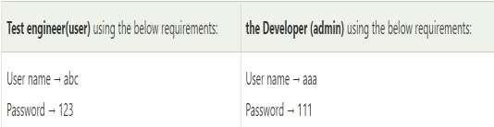
Platform mismatch: Test engineer using the different Platform (window 7 and Google Chrome browser), and the Developer using the different Platform (window XP and internet explorer) as well.
Build mismatch:
The test engineer will find the bug in one Build, and the Developer is reproducing the same bug in another build. The bug may be automatically fixed while fixing another bug.
Data mismatch
Different Values used by test engineer while testing & Developer uses different values.
Inconsistent bug:
For example:
The requirement is given for admin and user.
The Bug is found at some time, and sometime it won't happen.
Solution for inconsistent bug:
As soon as we find the bug, first, take the screenshot, then
developer will re-confirm the bug and fix it if exists.
I.e., both are using a different value for the same login module.

Slide 38
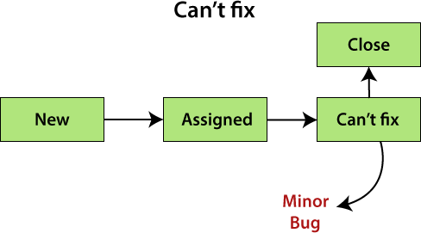
Can't fix
Reasons for the can't fix status of the bug:
When Developer accepting the bug and also able to reproduce, but
can't do the necessary code changes due to some restrictions.
Following are the constraints or reasons for the can't fix bug:
No technology support: The programming language we used itself not having the capability to solve the problem.
The Bug is in the core of code (framework): If the bug is minor (not important and does not affect the application), the development lead says it can be fixed in the next release.Or
if the bug is critical (regularly used and important for the
business) and development lead cannot reject the bug.
The cost of fixing a bug is more than keeping it.

Slide 39
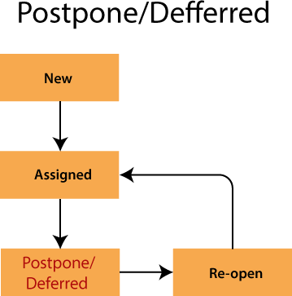
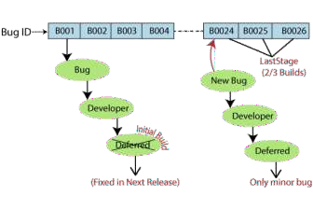
Deferred / postponed:
The deferred status of the bug was not fixed in the initial build
because of the time constraints.
The deferred/postpone is a status in which the bugs are postponed
to the future release due to time constraints.
As we can see in the below image:
The Bug ID-B001 bug is found at the initial build, but it will not be fixed in the same build, it will postpone, and fixed in the next release.
And Bug ID- B0024, B0025, and B0026 are those bugs, which are found in the last stage of the build, and they will be fixed because these bugs are the minor bugs.

Slide 40

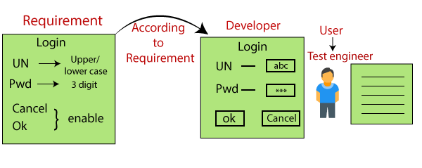
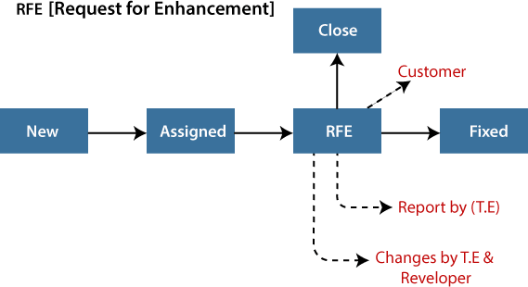
As we can see in the below example image that the test engineer thinks that the look and feel of the application or software are not good because the test engineer is testing the application as an end-user, and he/she will change the status as RFE.
RFE (Request for Enhancement):
And if the customer says Yes, then the status should be Fix. Or
These are the suggestions given by the test engineer towards the enhancement of the application in the form of a bug report. The RFE stands for Request for Enhancement.
If the customer says no, then the status should be Close.

Slide 41
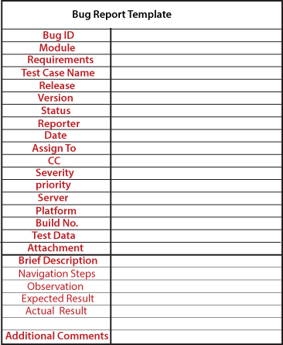
Bug Report Template (excel):
Bug ID: it is a unique number given to the bug.
Test case name: When we find a bug, we send a bug report, not the test case to the concerned developer. It is used as a reference for the test engineer.
Severity: It is the impact of a bug on the application. It can be a blocker, critical, major, and minor.
Priority: In this, we have to decide which bug has to be fixed first. It could be P1/P2/P3/P4, urgent, high, medium, and low.
Status: The different status of the bug which could be assigned, invalid, duplicate, deferred, and so on.
Reporter: In this, we will mention the name of the person who found the bug. It could be the test engineer, and sometime it may be a developer, business analyst, customer, etc.
Date: It provides the date when the bug is found.

Slide 42
Release/Build Version: It provides the release number in which the bug occurs, and also the build version of the application.
The Drawback of a manual bug report
Following are the disadvantages of manual bug report:
Time consuming
While searching every bug in the bug report, it will be time taken process.
Possibility of human error
A bug may be repeated, wrong data mentioned in the bug report, and miss something to add on the bug report.
No security
Anyone can change it or delete it.
Tedious process
No centralized repository
Platform: Mention the platform details, where we exactly find the bug.
Description: In this, we will explain the navigation steps, expected
and actual results of the particular bug.
Attachments: Attach the screenshots of the bug, which we captured because it helps the developers to see the bug.

Slide 43
END

